Slide 1
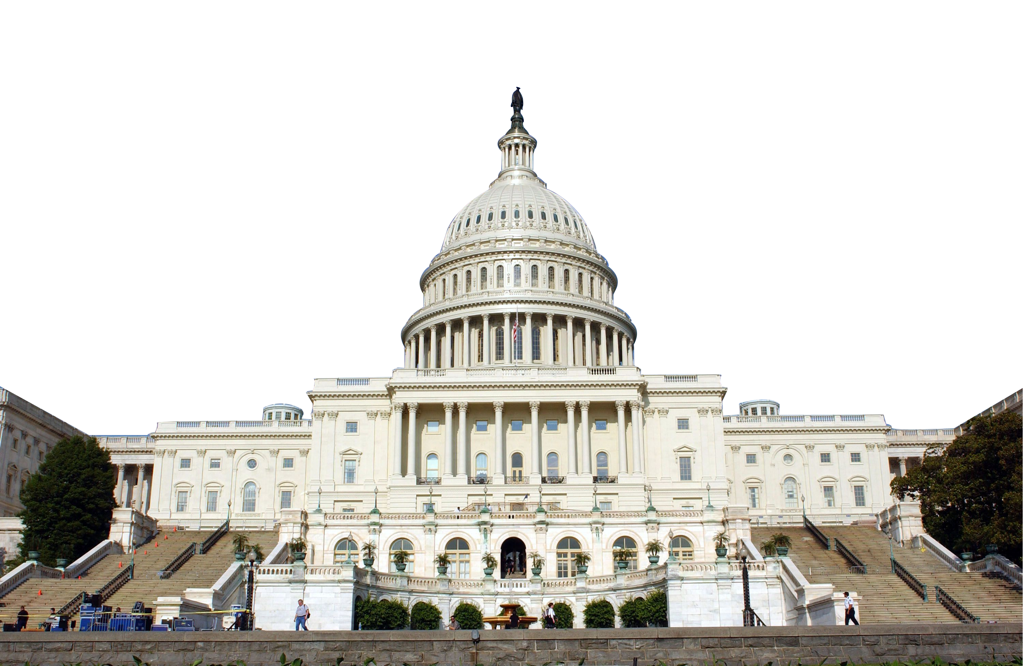
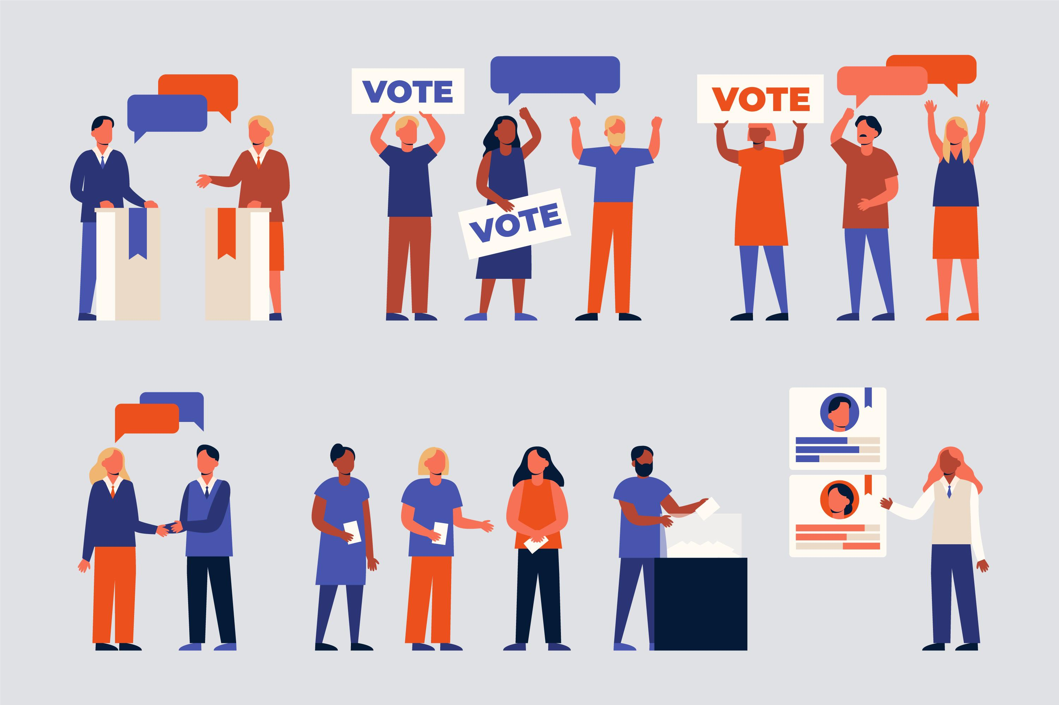
US Presidential Elections 2000 – 2020
A Data analysis of USA states votes in the 21th century
Breno Batista Caetano
IBM capstone project
2022

Slide 2
Executive Summary
Introduction
Methodology
Results:
Visualization – Charts and Maps
Dashboard
Conclusion
Outline

Slide 3

Executive Summary
Methodologies
Data collection and wrangling:
python, folium, dash, SQL
Data exploration:
Python, SQL
Data visualization:
Python-folium and plotly, dash, SQL-Power Bi
Machine learning:
sckit-learn
Main Objective of the analysis:
Find how USA states changed their voting habit in the 21 century.
Secondary objectives of the analysis:
1- Find which states in the USA tend to vote for the Democrats
2- Find which states in the USA tend to vote for the Republicans
3- Find if and which states populations of USA changed their voting in the last 20 years.

Slide 4
Introduction
Background and context:
This Presentation has been created for both general public and strategical political analysts that want to understand the voting habits of States in the USA in the 21 century.
With only 2 major parties, the USA voting system is very rigid. Most of the States in USA have already set in which party they will vote, leaving only a handful of States open to change.
The aim of this analysis is to show which States vote Republic, which vote Democratic and which are susceptible to change. It also aims to find party trends in the States open to change.
Main Objective of the analysis:
Find how USA states changed their voting habit in the 21 century.
Secondary objectives of the analysis:
1- Find which states in the USA tend to vote for the Democrats
2- Find which states in the USA tend to vote for the Republicans
3- Find if and which states populations of USA changed their voting in the last 20 years.

Slide 5
Methodology

Slide 6
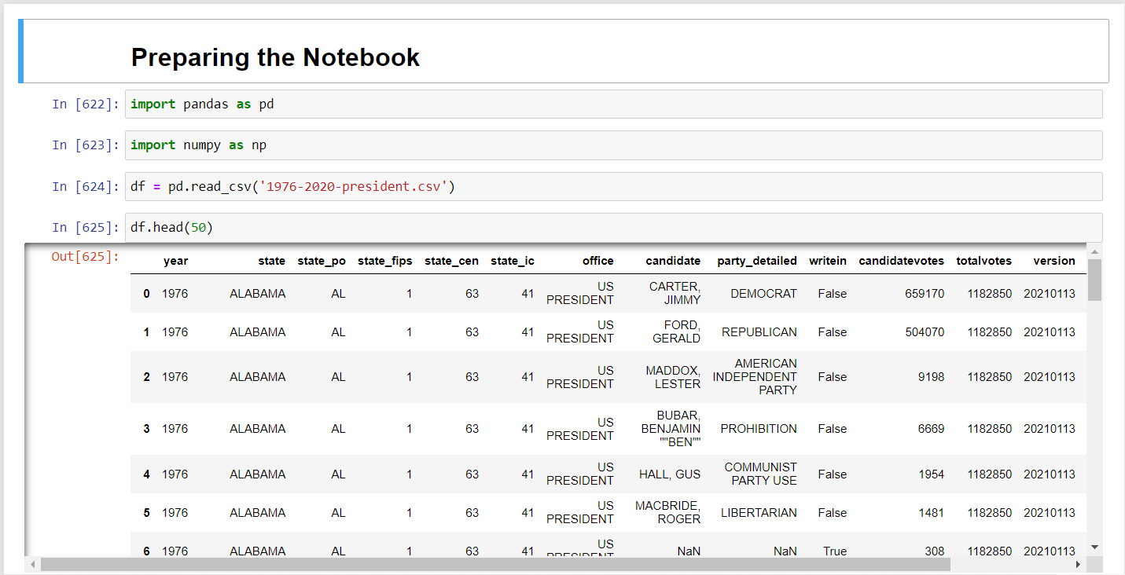
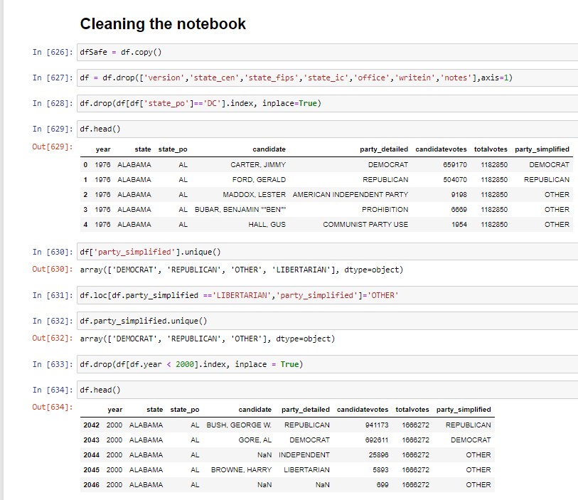
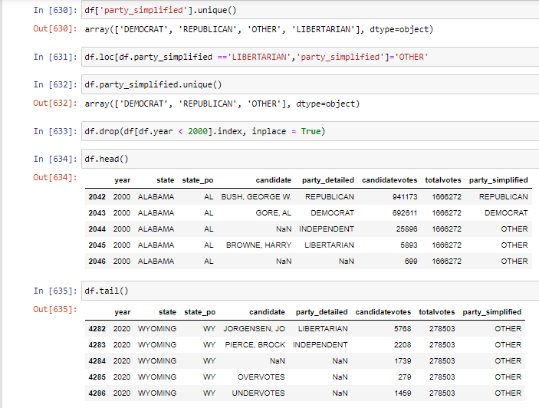
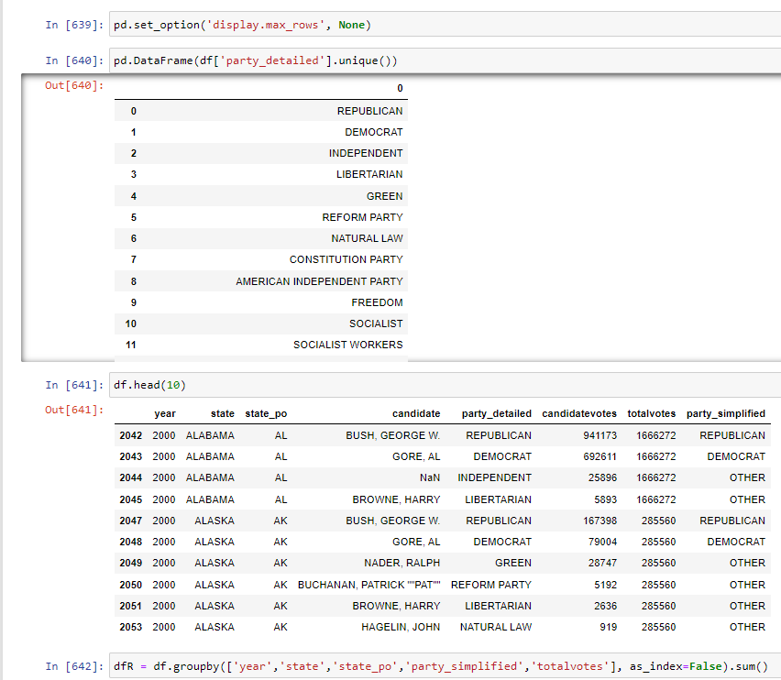
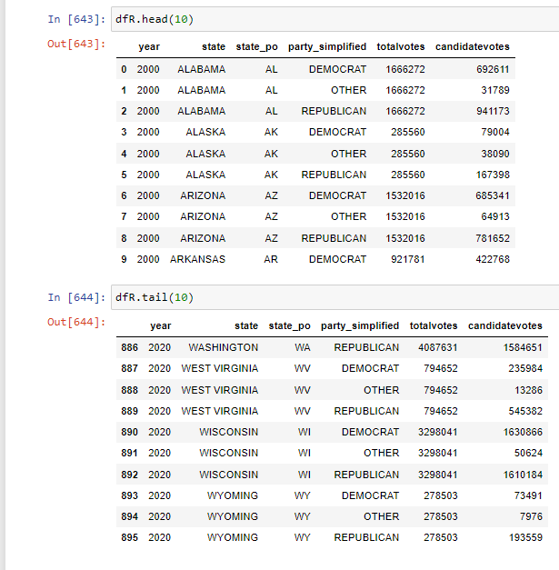
1- Data collection and wrangling
The data was collected via kaegle and was wrangled and cleaned using python:

Slide 7
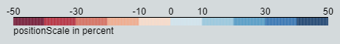
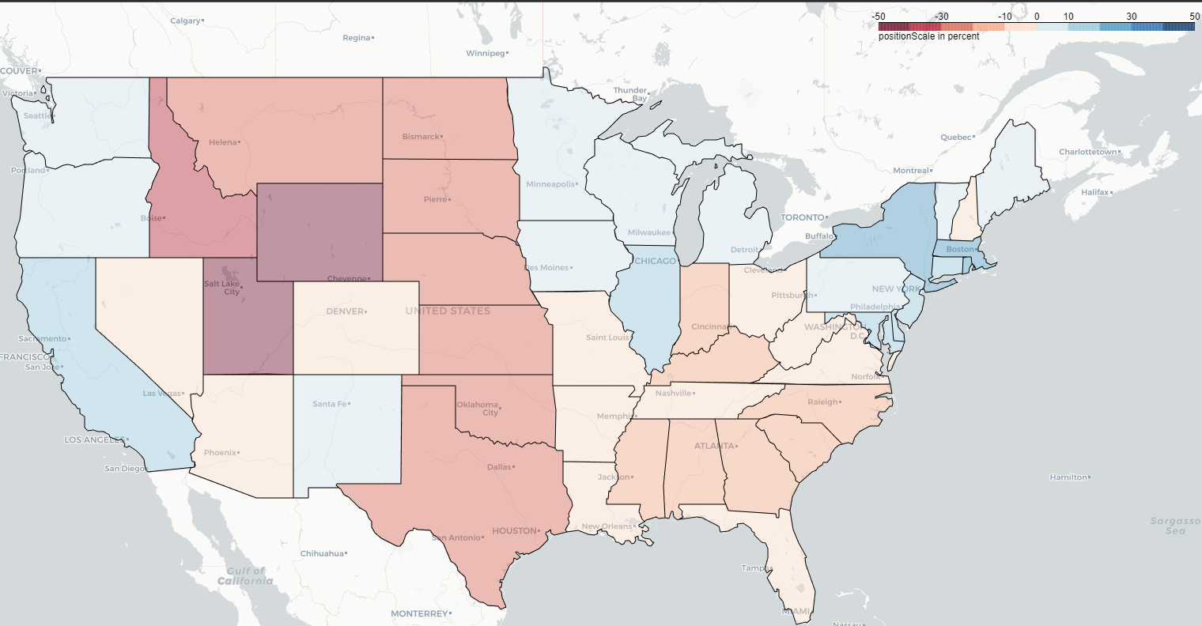
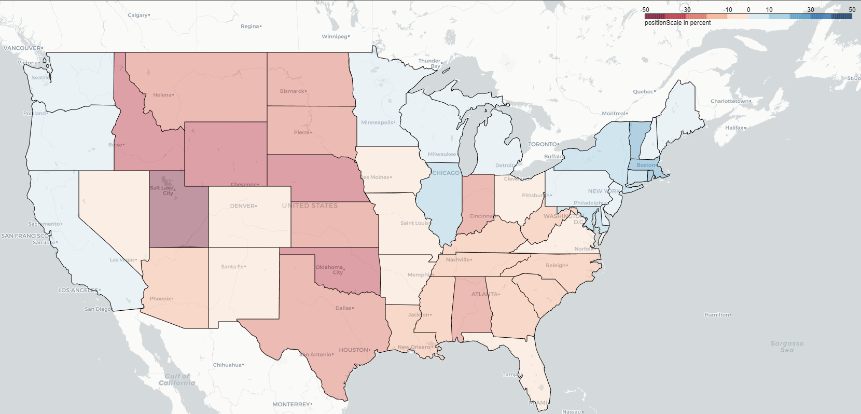
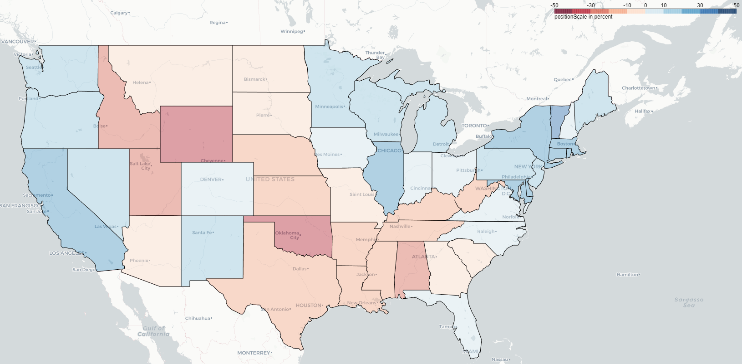
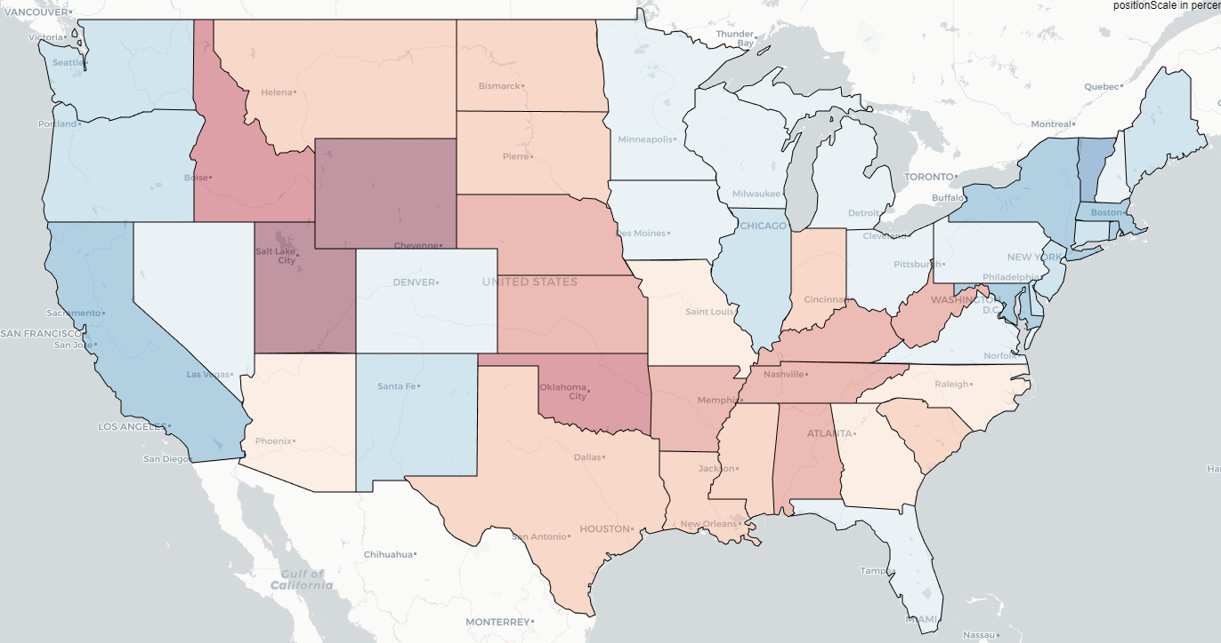
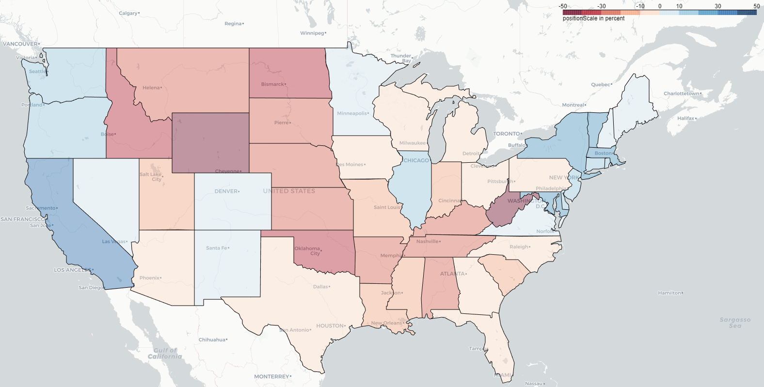
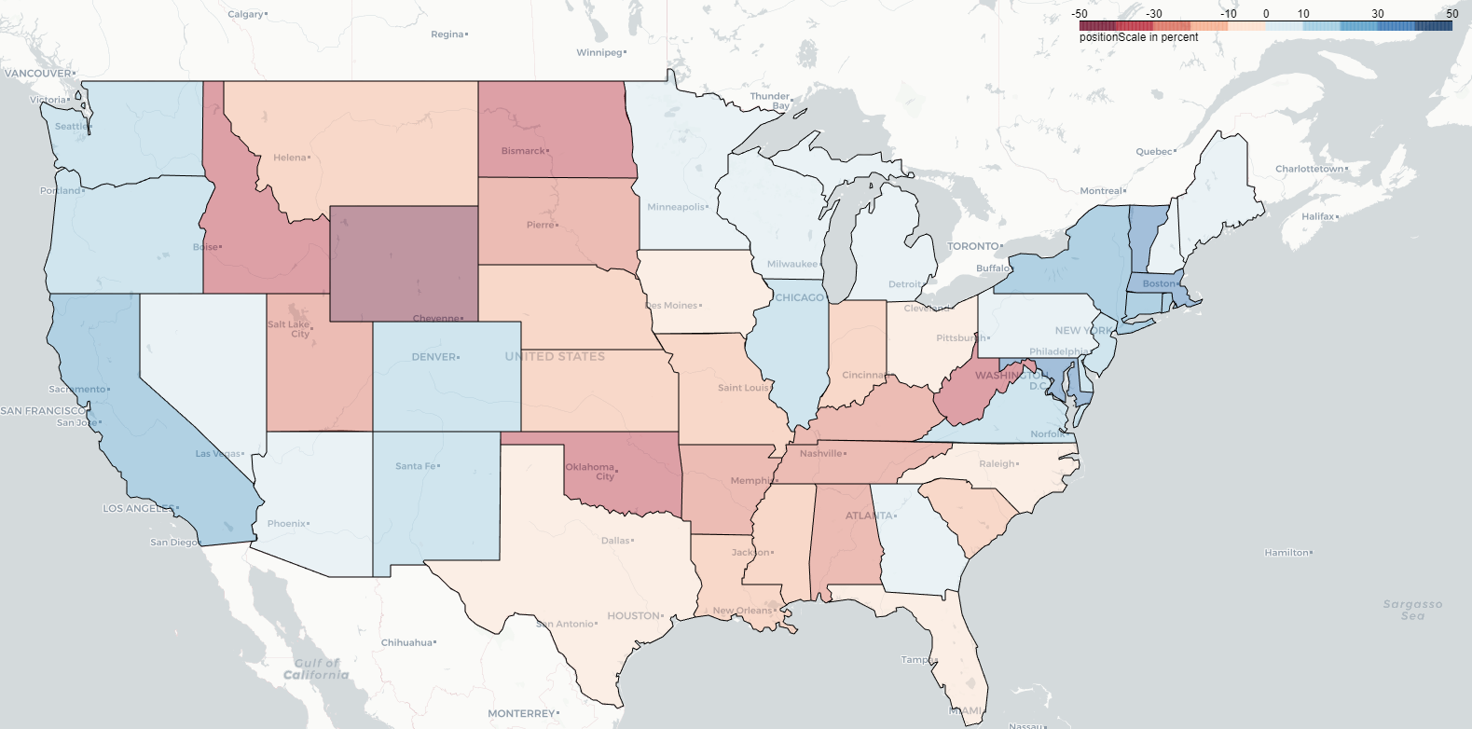
2- Visualization
Surplus Vote Percent: shows how much more was the voting percentage of the winning state party.
The republicans are represented by the the negative percentages (red), while the democrats are represented by the positive percentages (blue)
Elections map of the last 20 years
The following maps shows the intensity of United States votes of the last 20 elections using the Surplus Vote Percnet*
Republicans
Surplus Vote Percent
Democrats
2000 Elections
2004 Elections
2008 Elections
2012 Elections
2016 Elections
2020 Elections

Slide 8
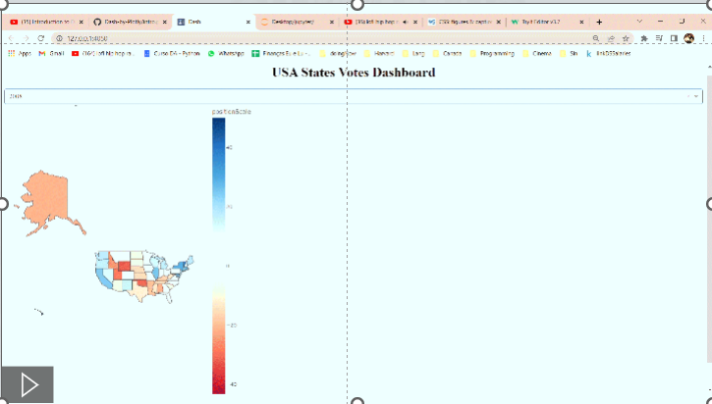
Elections map of the last 20 years
With Plotly Dash
Surplus Vote Percent: shows how much more was the voting percentage of the winning state party.
The republicans are represented by the the negative percentages (red), while the democrats are represented by the positive percentages (blue)
The following interactive map shows the intensity of United States votes of the last 20 elections using the Surplus Vote Percent*.
It also shows the total, Republican and Democrats per state in United States during the period of (2000 – 2020).
Republicans
Surplus Vote Percent
Democrats

Slide 9
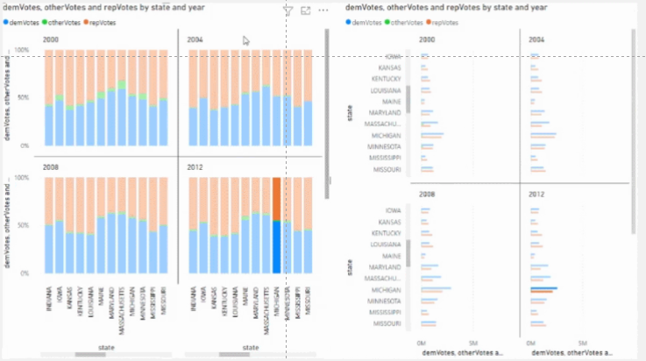
Elections graph of the last 20 years with SQL and Power Bi
Republicans are represented in red, democrats in blue and other parties (green, libertarian, etc.) are represented in green.
The graphs (ploted in power bi) shows the elections results in each state for the 2 major parties (Democrat and Republican) for the last 20 years.
Republican
Democrat
Other parties

Slide 10
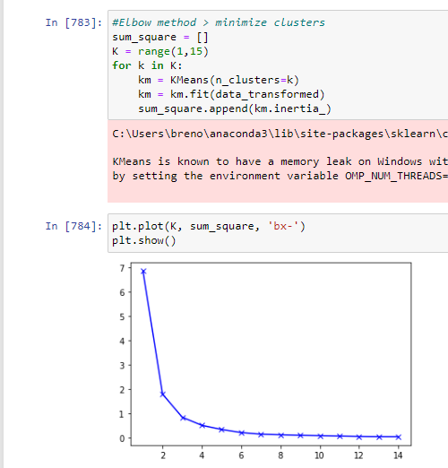
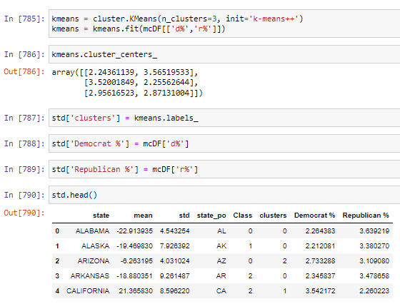
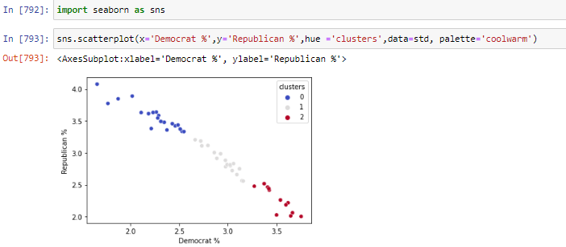
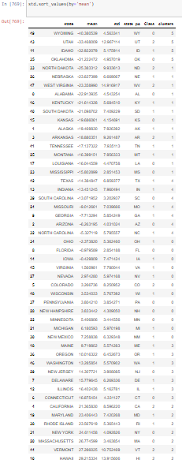
3- Machine Learning
Using machine learning – kcluster in sckit-learn – we were able to classify the states in 3 clusters (using the elbow technique): states that vote republican (red), states that vote democrat (blue) and states in between (white), meaning that they can vote wither republican or democrat.
Elbow technique:
Kmeans cluster (sckit-learn) using the ideal numbers of clusters in the elbow technique:
States divided in their cluster
Republican states: Wyoming, Utah, Idaho, Oklahoma, North Dakota, Nebraska, West Virginia, Alabama, Kentucky, South Dakota, Kansas, Alaska, Arkansas, Tennessee, Montana, Louisiana, Mississippi, Texas, Indiana, South Carolina
Democrat states: Washington, New Jersey, Delaware, Illinois, Connecticut, California, Maryland, Rhode Island, New York, Massachusetts, Vermont, Hawaii
Neutral states: Missouri, Georgia, Arizona, North Carolina, Ohio, Florida, Iowa, Virginia, Nevada, Colorado, Wisconsin, Pennsylvania, New Hampshire, Minnesota, Michigan, New Mexico, Maine, Oregon

Slide 11
Results

Slide 12
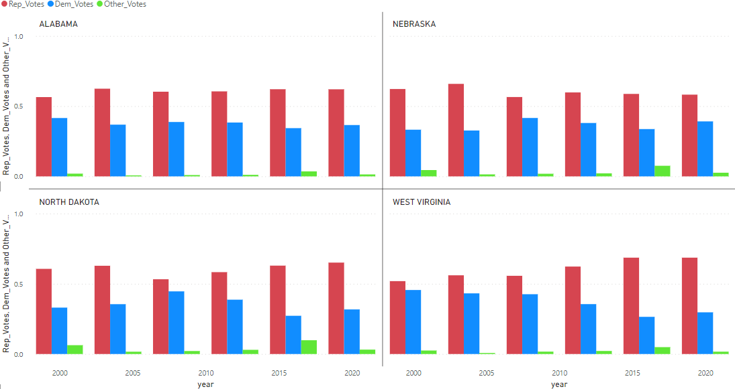
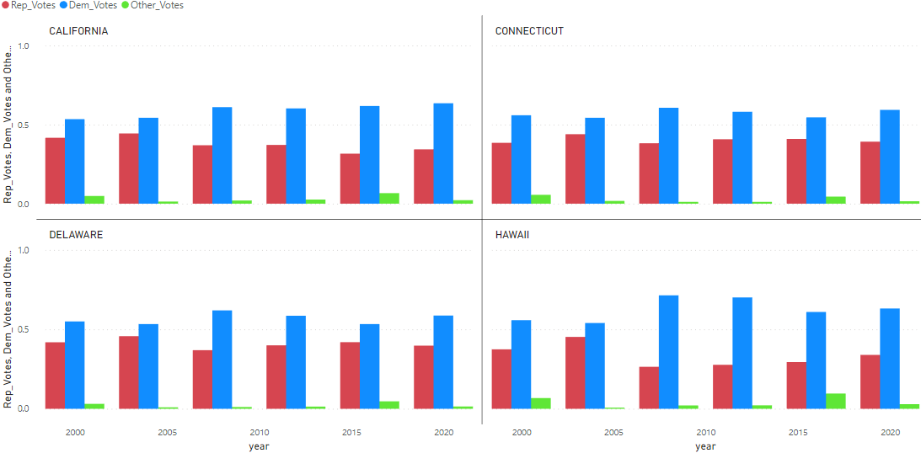
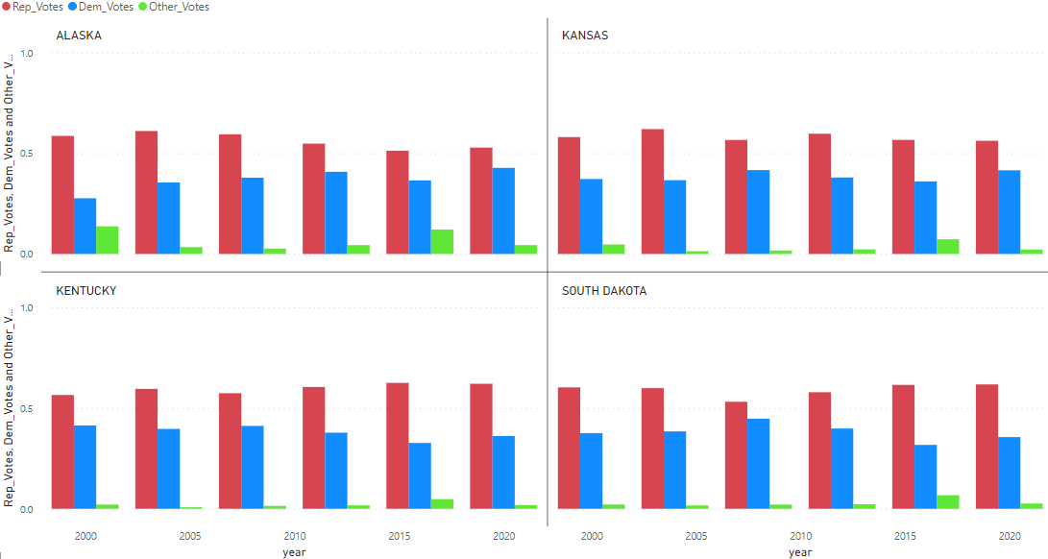
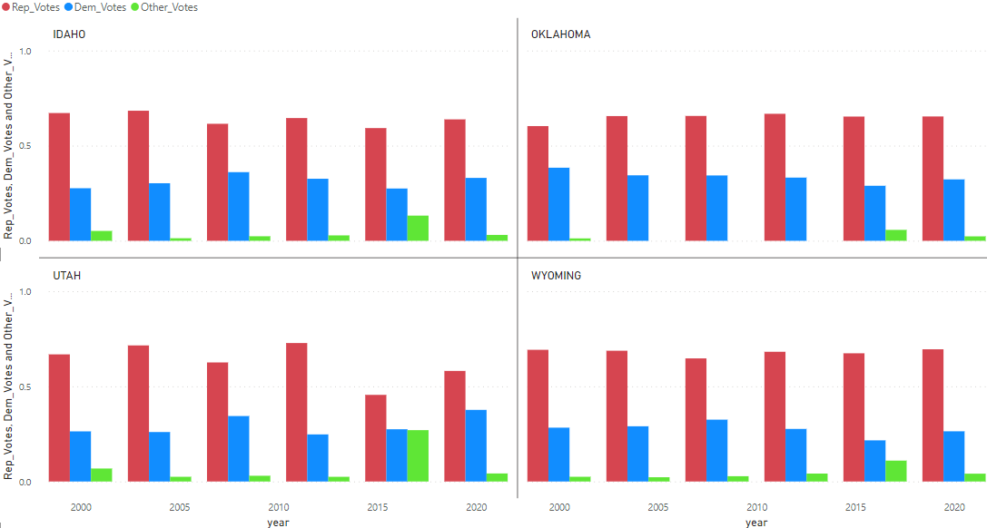
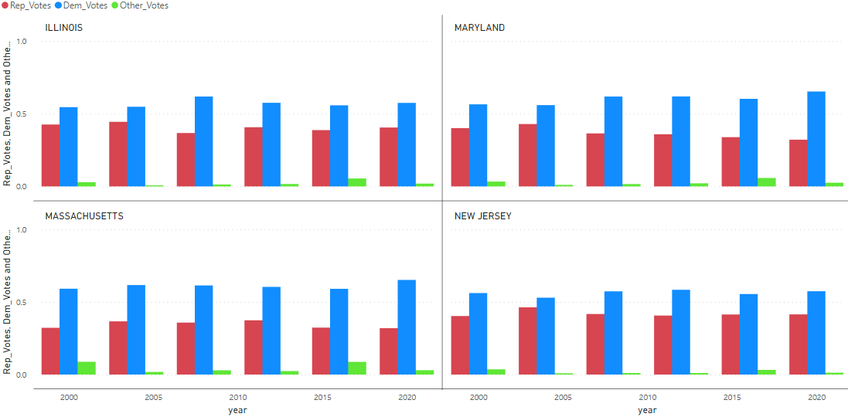
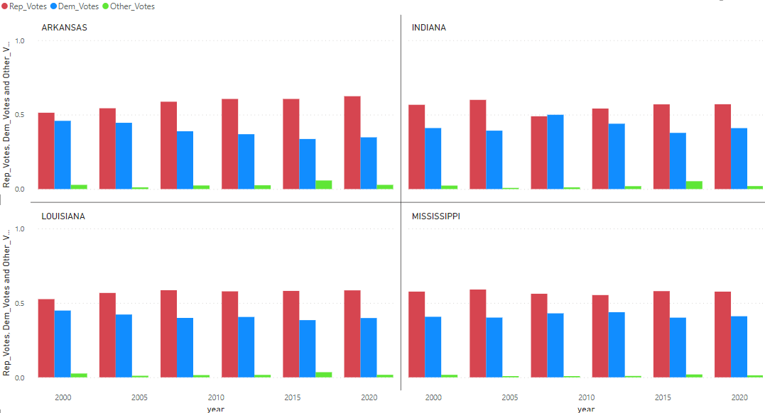
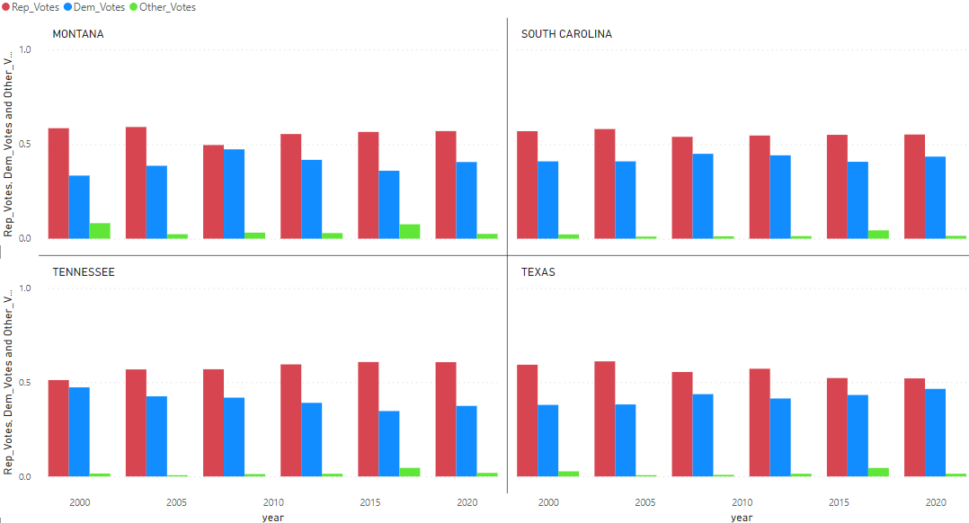
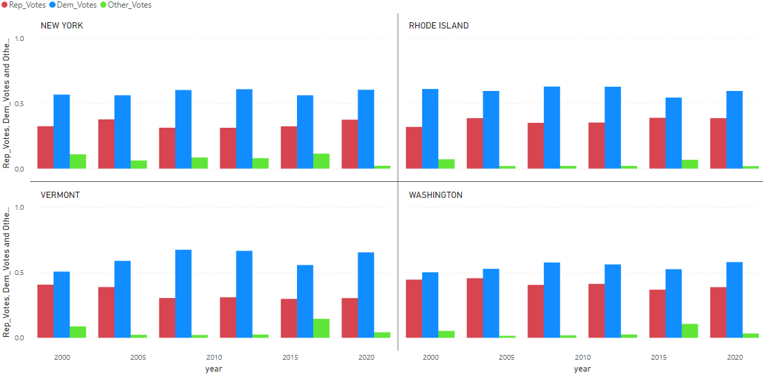
Elections in the 3 groups (2000 – 2020):
Republican States
Democrat States
Neutral states: Missouri, Georgia, Arizona, North Carolina, Ohio, Florida, Iowa, Virginia, Nevada, Colorado, Wisconsin, Pennsylvania, New Hampshire, Minnesota, Michigan, New Mexico, Maine, Oregon

Slide 13
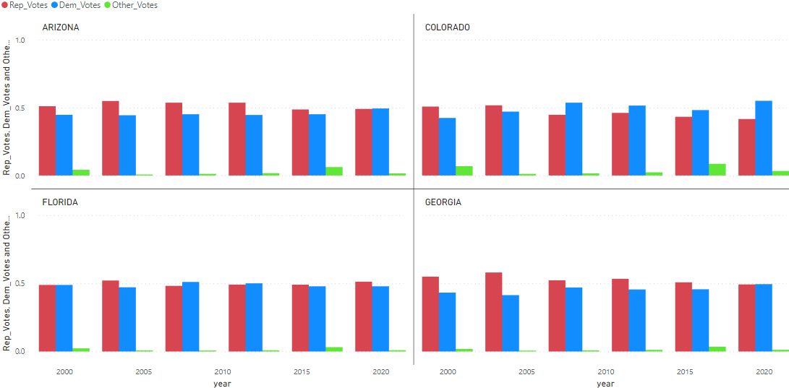
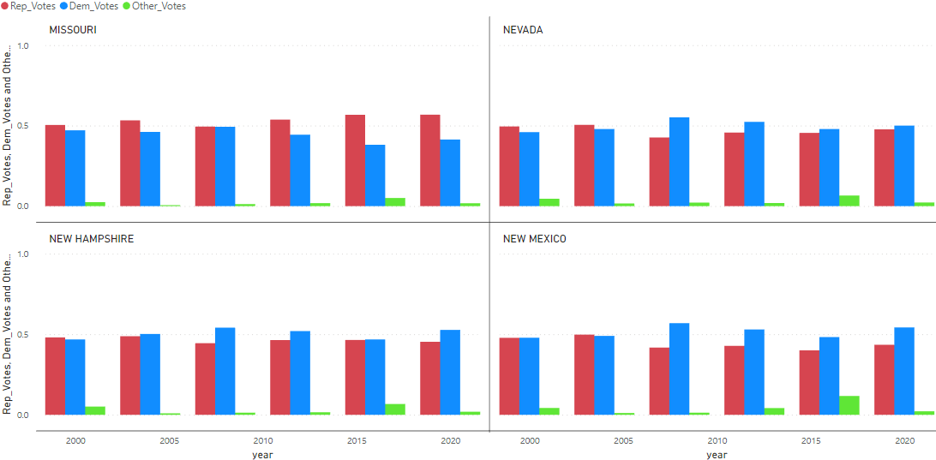
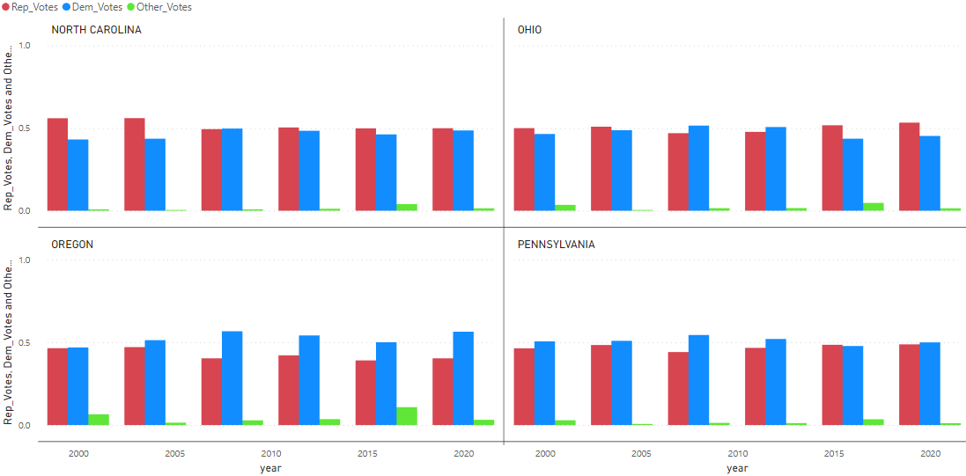
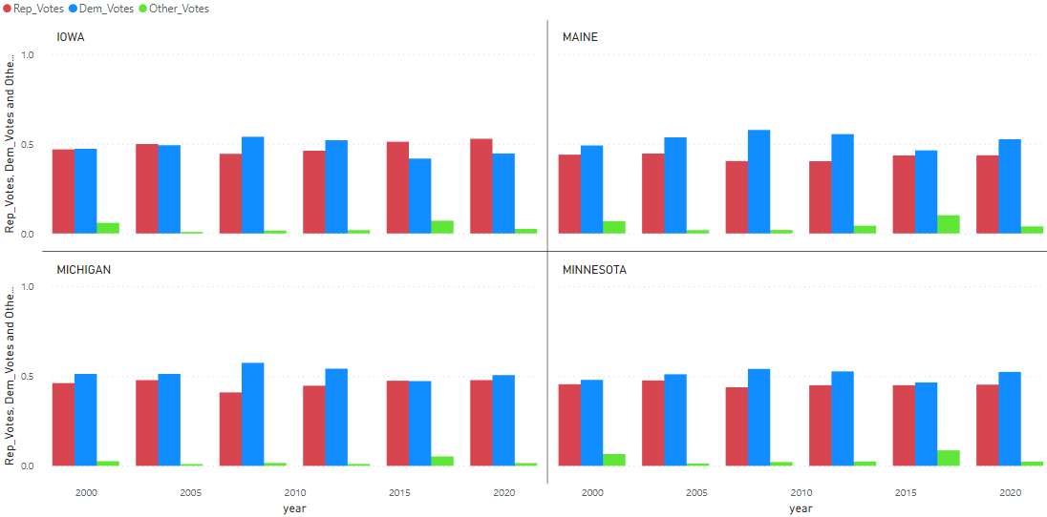
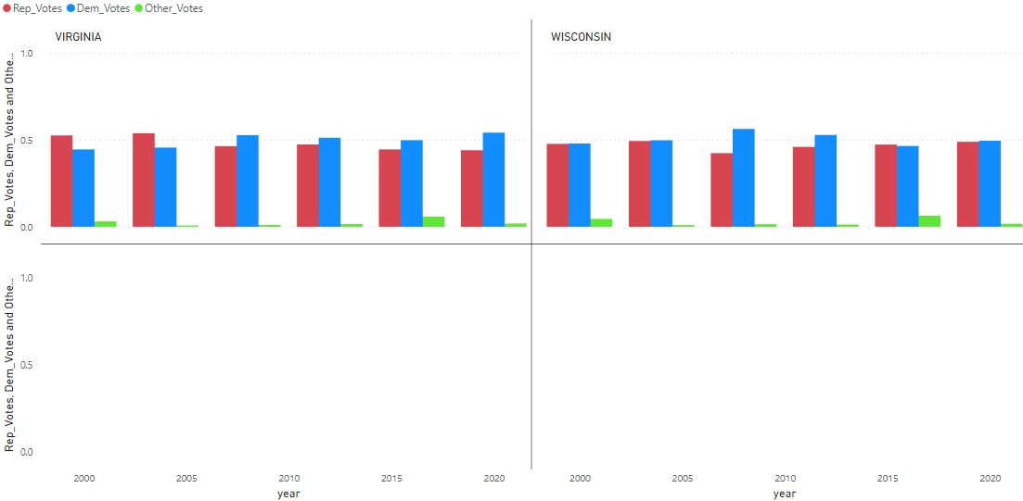
Elections in the 3 groups (2000 – 2020):
Neutral States
Neutral states: Missouri, Georgia, Arizona, North Carolina, Ohio, Florida, Iowa, Virginia, Nevada, Colorado, Wisconsin, Pennsylvania, New Hampshire, Minnesota, Michigan, New Mexico, Maine, Oregon

Slide 14
3- States that changed their way of voting in the last 20 years.
As seen in the last graphs, both states in the parties cluster (Democratic and Republican) did not change their way of voting in the last 20 years. In the Republican cluster the Republican party won every single election during the whole period and the same goes to the Democratic cluster, that the Democratic Party won every election for the last 20 years.
That situation changes in the neutral cluster, that some states, but not all, changed their way of voting.
Looking into the graphs we can divide the states in 2 groups, that is, states that changed their way of voting, that means, States that we can clearly see a trend in their voting way and States that we can not, namely, States that might change the winning party but that not showcase a trend in their voting habit.

Slide 15
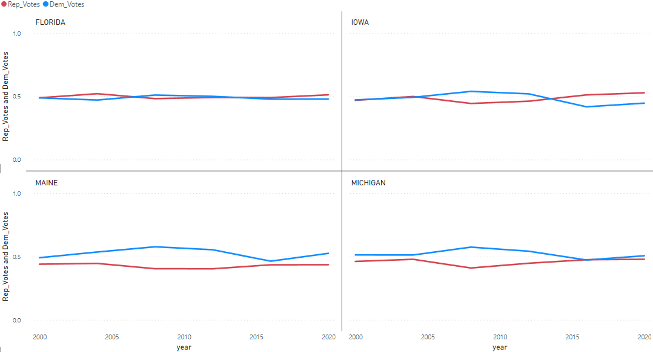
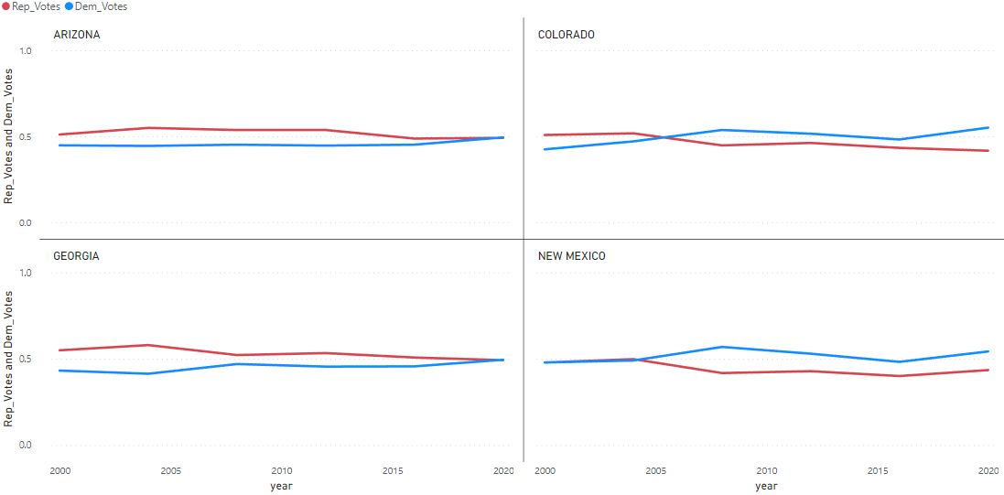
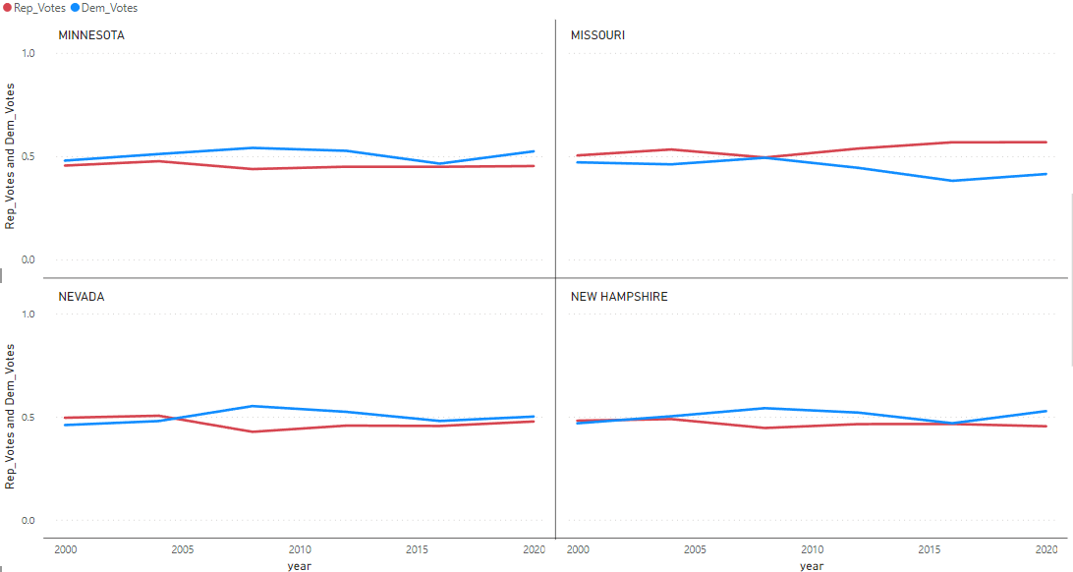
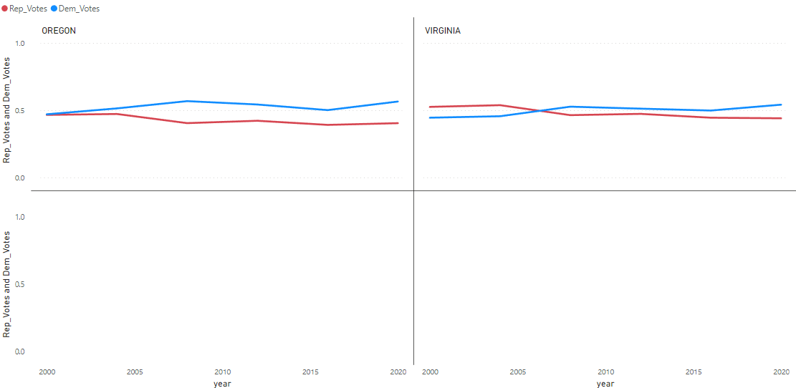
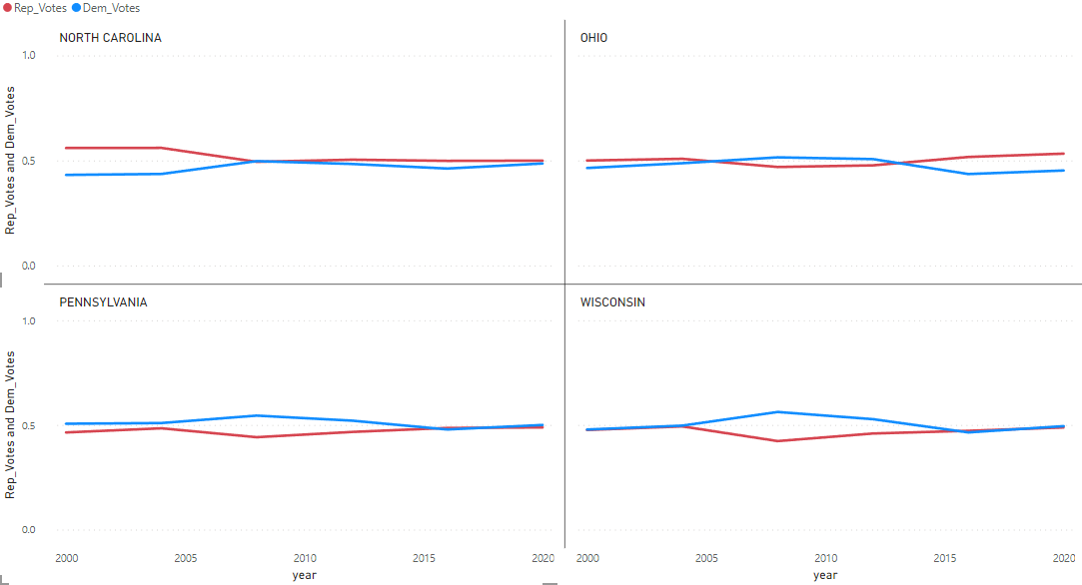
States that presented a trend in their way of voting:
States that did not presented a trend in their way of voting:
Neutral States
Changed the voting way: Arizona, Colorado, Georgia, New Mexico, Oregon, Virginia
Did not changed the voting way: Florida, Iowa, Maine, Michigan, Minnesota, Missouri, Nevada, new Hampshire, north Carolina, Ohio, Pennsylvania, Wisconsin

Slide 16
Conclusion

Slide 17
Conclusions:
Of the 50 States in USA:
20 have the Republican Party as their major party: Wyoming, Utah, Idaho, Oklahoma, North Dakota, Nebraska, West Virginia, Alabama, Kentucky, South Dakota, Kansas, Alaska, Arkansas, Tennessee, Montana, Louisiana, Mississippi, Texas, Indiana, South Carolina.
12 have the Democratic party as their major party: Washington, New Jersey, Delaware, Illinois, Connecticut, California, Maryland, Rhode Island, New York, Massachusetts, Vermont, Hawaii
18 are Neutral, namely, do not have a clear major party: Missouri, Georgia, Arizona, North Carolina, Ohio, Florida, Iowa, Virginia, Nevada, Colorado, Wisconsin, Pennsylvania, New Hampshire, Minnesota, Michigan, New Mexico, Maine, Oregon
Of the 18 Neutral States, 6 (Arizona, Colorado, Georgia, New Mexico, Oregon, Virginia) presented the same voting trend for the last 20 years, expressly going away from the Republican Party and into the Democratic party.
Changed the voting way: Arizona, Colorado, Georgia, New Mexico, Oregon, Virginia
Did not changed the voting way: Florida, Iowa, Maine, Michigan, Minnesota, Missouri, Nevada, new Hampshire, north Carolina, Ohio, Pennsylvania, Wisconsin

